Slide 1
The Impact of the Enhanced Premium Tax Credit on Uninsurance, Premiums, and State Innovation
Claire Heyison, Center on Budget & Policy Priorities
Laura Colbert, Georgians for a Healthy Future
Notes:
Intros: names, orgs.

Slide 2
Timeline of the Enhanced Premium Tax Credits
March 2021
August 2023
December 31, 2025
American Rescue Plan Act (ARPA) enacted
The Inflation Reduction Act extended the enhancements for 2023-2025
Enhanced APTCs expire (if no Congressional action is taken)

Slide 3
Enhanced premium tax credits
Lower caps on premium contributions for people of all income levels
Allow people with incomes between 100-150% of the federal poverty level (FPL) to pay $0 in premiums for “benchmark” silver-level plans; and
Extend eligibility for PTCs to people with incomes above 400% FPL if their benchmark premiums would exceed 8.5% of household income.
For PY 2024, 92% of marketplace enrollees qualified for PTCs.
~19.7 million Americans

Slide 4
Premium cost limits: Pre- and Post-Enhancements
Percent of Income Paid for Marketplace Benchmark Silver Premium, by Income
Income (% of poverty) | Pre-Enhancement | Post-Enhancement
Under 100% | Not eligible for tax credits | Not eligible for tax credits
100% – 138% | 2.07% | 0.0%
138% – 150% | 3.10% – 4.14% | 0.0%
150% – 200% | 4.14% – 6.52% | 0.0% – 2.0%
200% – 250% | 6.52% – 8.33% | 2.0% – 4.0%
250% – 300% | 8.33% – 9.83% | 4.0% – 6.0%
300% – 400% | 9.83% | 6.0% – 8.5%
Over 400% | Not eligible for tax credits | 8.5%
Notes:
Leave in, but no comments here.

Slide 5
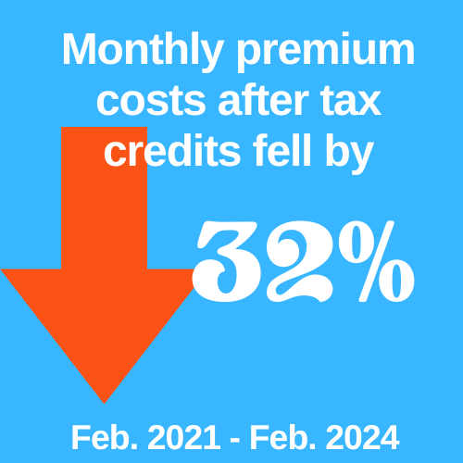
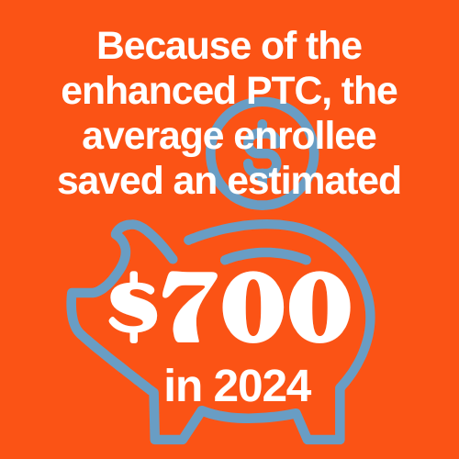
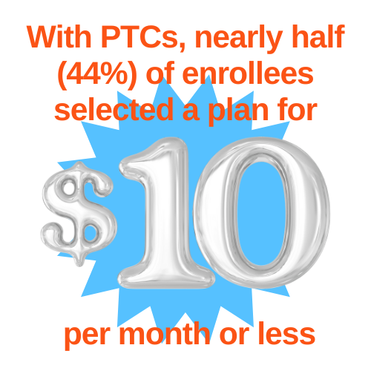
How much have people saved?
Notes:
https://www.cms.gov/data-research/statistics-trends-reports/marketplace-products/2024-marketplace-open-enrollment-period-public-use-files
https://www.hhs.gov/about/news/2024/03/22/celebration-10-years-aca-marketplaces-biden-harris-administration-releases-historic-enrollment-data.html
Monthly premium costs after tax credits fell by 32 percent, on average, from February 2021 to February 2024.
In 2024, the average enrollee saved an estimated $700 because of the enhanced PTC.
Nearly half (44 percent) of enrollees selected a plan for $10 per month or less during open enrollment for 2024 coverage, after PTCs.

Slide 6
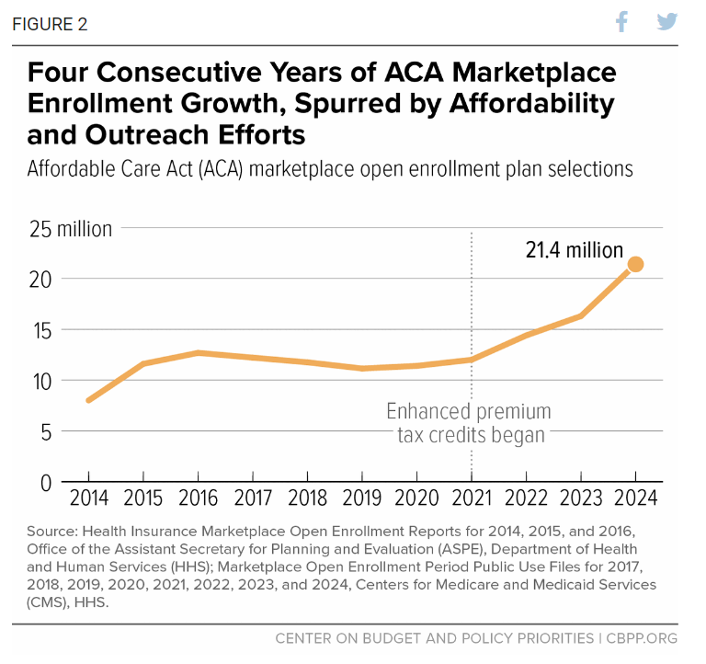
How have enhanced PTCs affected coverage?
The enhancements to premium tax credits were a primary cause of large marketplace enrollment gains since 2021
Other factors: increased outreach and enrollment assistance, extended enrollment periods, and (for 2024) the unwinding of the Medicaid continuous coverage requirement

Slide 7
If the enhanced PTCs expire
Marketplace enrollees will pay more for their coverage
More people will become uninsured
States will have reduced resources for their affordability initiatives

Slide 8
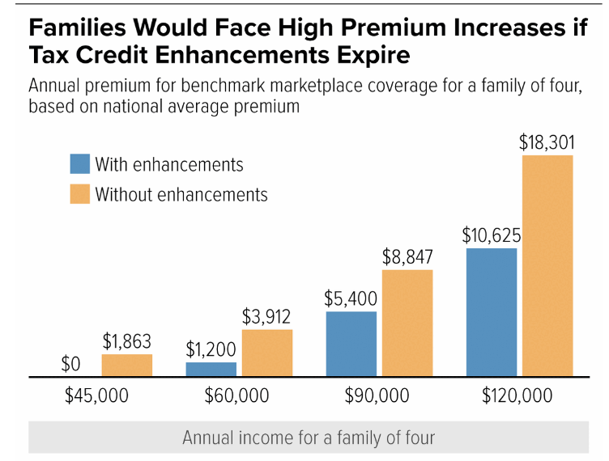
If the enhanced PTCs expire: Increased premiums
The vast majority of enrollees would face higher premium costs.
Annual premium costs would double for people with incomes 200-300% FPL, and would increase 5-fold for people with incomes 150-200% FPL.
Annual premium costs for people with incomes less than 150% of the FPL would increase from $0 to roughly $400 per person.
CBPP: Health Insurance Costs Will Rise Steeply if Premium Tax Credit Improvements Expire

Slide 9
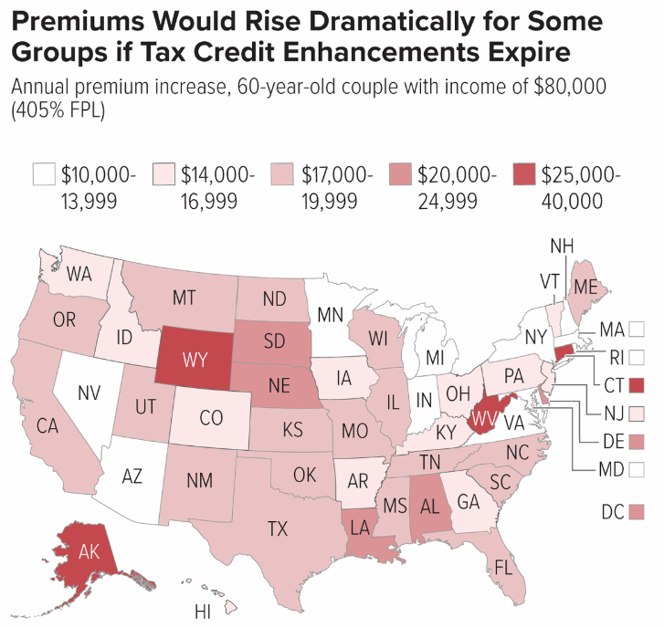
If the enhanced PTCs expire: Increased premiums
Premiums would rise most:
in states with high underlying marketplace premiums, like WV and WY;
for older enrollees, who pay higher premiums under ACA rules than younger people; and
for people with incomes above 400% FPL, who would lose subsidies entirely.
CBPP: Health Insurance Costs Will Rise Steeply if Premium Tax Credit Improvements Expire

Slide 10
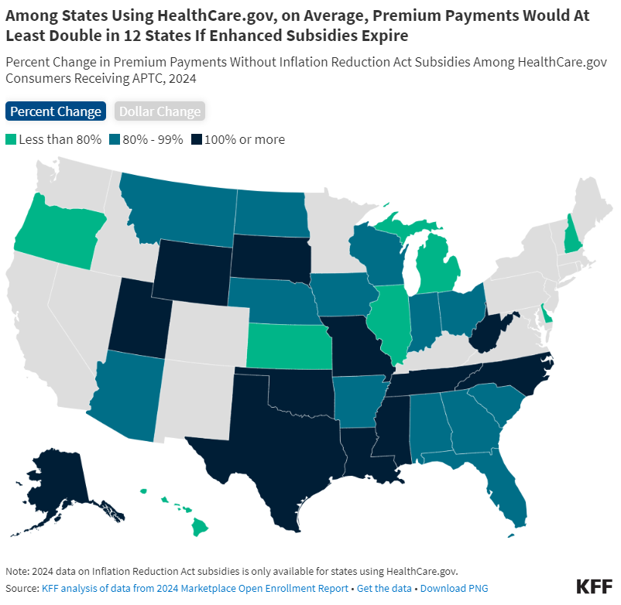
KFF: Inflation Reduction Act Health Insurance Subsidies: What is Their Impact and What Would Happen if They Expire?

Slide 11
If the enhanced PTCs expire: Increased uninsurance
Marketplace enrollment would decline by roughly 7.2 million people.
TX, SC, MS, LA, GA would see individual markets shrink by roughly 50 percent
About 4 million more people would be uninsured.
States that have not expanded Medicaid are most likely to experience spikes in uninsurance.
People with lower health risk are most likely to drop coverage, causing base premiums to rise.
Urban Institute: Who Benefits From Enhanced Premium Tax Credits in the Marketplace?

Slide 12
Cassie Cox, Bainbridge, GA
"When Cassie Cox ended up in the emergency room in January, the Bainbridge, Georgia, resident was grateful for the Obamacare insurance policy she had recently selected for coverage in 2024.
Cassie qualified for an Affordable Care Act marketplace plan with no monthly premium due to her relatively low income. And after she cut her hand severely, the 35 stitches she received in the ER led to an out-of-pocket expense of about $300, she said."
Source: Andy Miller, Presidential Election Could Decide Fate of Extra Obamacare Subsidies, KFF Health News, May 30, 2024.

Slide 13
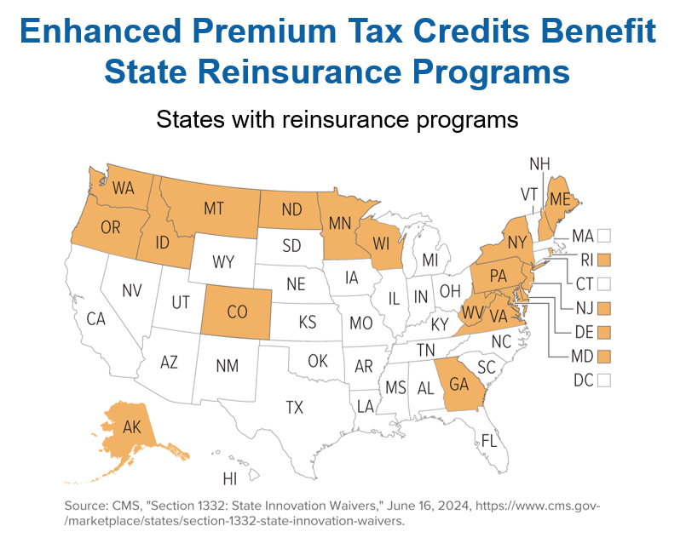
Impact on state affordability initiatives: Reinsurance
19 states operate reinsurance programs to reduce premiums in the individual market
Lower base premiums → lower federal expenditures on PTC
States use 1332 waivers to capture these savings and reinvest them into reinsurance, as well as other affordability initiatives
State reinsurance programs generate more savings for the federal government - and more revenue for states - under enhanced PTCs

Slide 14
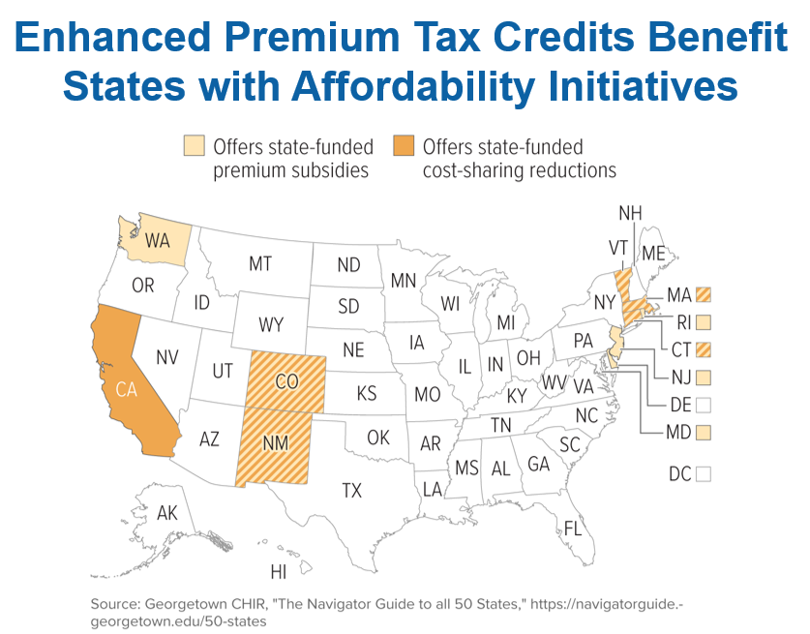
Impact on state affordability initiatives: Premium and Cost-Sharing Assistance
Ten states provide additional, state-funded premium and/or cost-sharing assistance to some or all marketplace enrollees
Enhanced PTCs lower premiums and make plans with more generous cost sharing more affordable, so states contribute less to affordability initiatives
If enhanced PTCs expire, states may decide to scale back affordability initiatives, adding to higher costs for enrollees and potentially increasing uninsurance

Slide 15
Timing of Needed Action
Spring 2025
Plans develop rates for PY 2026
December 2025
Enhanced APTCs Expire
Fall 2025
Open Enrollment begins for PY 2026
(ends January 2025)
January 2026 2026 coverage begins

Slide 16
Regulators should/may consider:
Urge your state’s Congressional delegation to extend the enhanced PTCs before June 2025
Examine data about the likely premium and uninsurance increases for your state. State-specific data:
Center on Budget & Policy Priorities, Entering Their Second Decade, Affordable Care Act Coverage Expansions Have Helped Millions, Provide the Basis for Further Progress.
Urban Institute, Who Benefits from Enhanced Premium Tax Credits in the Marketplace?
KFF, Inflation Reduction Act Health Insurance Subsidies: What is Their Impact and What Would Happen if They Expire?

Slide 17
Questions?
Claire Heyison
cheyison@cbpp.org
Laura Colbert
lcolbert@healthyfuturega.org

